Slide 1

Python for Data Analysis
Sue Bayes

Slide 2
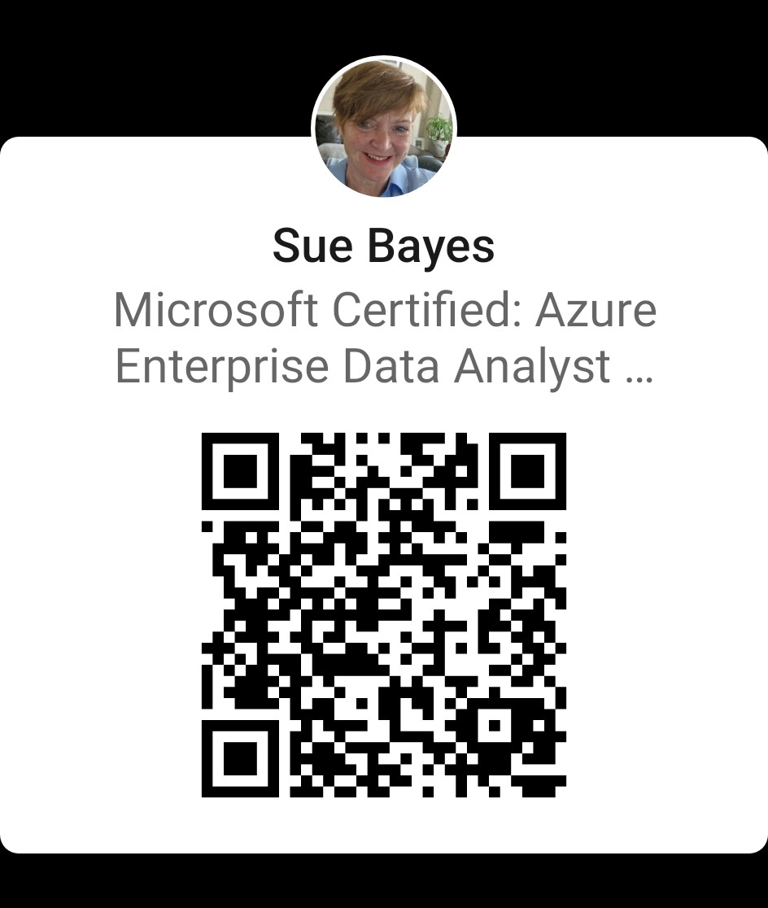
Sue Bayes https://www.linkedin.com/in/suebayes/
Independent Power BI developer
Own business
Love Data, Running and Yoga
www.databayes.co.uk
https://www.meetup.com/devon-and-cornwall-power-bi-meetup-group/
https://sqlbits.com/attend/the-agenda/wednesday/
Notes:
Who – where from?
Have you used Tabular Editor?

Slide 3


Session Plan
Introduction
Python basics
Libraries – NumPy & Pandas
Data cleaning
Visualisation - Matplotlib

Slide 4
Python
Python is a versatile tool for solving a wide range of problems, from creating websites and apps to analysing data and making predictions with artificial intelligence.
Libraries are central to this ability
It's easy to learn and use, making it popular for everything from automating small tasks on your computer to powering complex technologies behind the scenes.

Slide 5
Session Plan
Introduction
Python basics
Libraries – NumPy & Pandas
Data cleaning
Visualisation - Matplotlib

